Slide 1

Rochester City School District 2022 High Deductible Health Plan
Open Enrollment

Slide 2
Excellus HDHP
Medical | In Network | Out of Network
Deductible | $600 (single $1,200 (2-person/Family) | $5,000 (single $10,000 (2-person/Family)
Coinsurance | 0% | 40%
Out of Pocket Maximum | $4,000 (single) $8,000 (2 person/Family) | $10,000 (single) $20,000 (2 person/Family)
PCP Copay | $25 subject to deductible | 40% subject to deductible
Specialist Copay | $40 subject to deductible | 40% subject to deductible
Emergency Room Copay | $150 subject to deductible | $150 subject to deductible
Urgent Care | $60 copay subject to deductible, | No Coverage
Adult Routine Eye Exams | No Coverage | No Coverage
Pediatric Routine Eye Exams | No Coverage | No Coverage
Prescription Drug Coverage | $10/$35/$70 subject to deductible | No Coverage
Dependent Coverage | To Age 26 | To Age 26

Slide 3


Preventative Services Covered in Full
Well child visits
Adult routine physicals
Adult immunizations
Well-woman examinations
Mammograms
Preventive Screenings
Flu shots
Routine Colonoscopies
*Please refer to your plan benefit summaries for a complete list of services
that are covered in full*

Slide 4

Telemedicine powered by MDLIVE*
When to Use Telemedicine Benefits
If your primary care doctor is not available
Instead of going to the ER or an urgent care center (for a non-emergency medical issue)
Traveling and in need of medical care
After registering your account at MDLIVE, the cost will appear after selecting to see a provider – MDLIVE will know what to charge based on your plan
Common Conditions Treated Include:
Non-Emergency Medical Telemedicine
Allergies
Asthma
Cold & Flu
Constipation
Diarrhea
Fever
Behavioral Health Telemedicine
Addictions
Anxiety
Bipolar
Disorders
Depression
Eating
Disorders
Headache
Insect Bites
Joint Aches
Nausea
Pink Eye
Rashes
LGBTQ Support
Grief & Loss
Men’s Issues
Panic Disorders
Stress
Trauma & PTSD
Women’s
Issues
Audio Call In: 1-855-852-7677
Access Code: 2384263
*Availability varies per group
Notes:
As mentioned earlier, another alternative to use is telemedicine if you need to seek medical care for a non emergent medical condition or a behavioral health condition.
Excellus BlueCross BlueShield’s telemedicine program is powered through MDLIVE. Please note that availability of this service varies per group, so be sure to check with your HR department or check your Excellus online account to make sure it is available to you!
Telemedicine is a service that delivers low-cost access to virtual healthcare 24/7, 365 days out of the year with a board-certified physician. This can be done through audio only such as a phone call, or through video chat. You can use telemedicine for a variety of non, emergency medical conditions such as a rash, cold, pink eye and more. You can also use telemedicine for a Behavioral Health visit for conditions such as anxiety, stress, grief and loss, and addiction.
MDLIVE providers can diagnose based on medical criteria, prescribe medications when appropriate and send them right to your pharmacy!
So when should you use telemedicine? Telemedicine can be used if your primary care physician is unavailable such as after hours or weekends, if you’re traveling anywhere in the United States, if you can’t leave work or home for any reason, or if you have a child on your plan that is away at college.
The cost can vary for services delivered, but once you create your account with MDLIVE the cost for each visit will be displayed to you prior to setting up an appointment.
Payment can be made with any major credit card, HSA, FSA or HRA card.

Slide 5
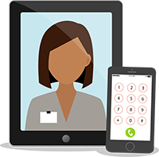


Telemedicine - Setup to Get Started*
Getting Started
Start by visiting MDLIVE to setup your Telemedicine visit.
New users:
Complete a one-time registration
Setup a MyHealth profile
1
WEB – Register/Log in at ExcellusBCBS.com/Member
Don’t wait until you need it. There are four easy ways to activate telemedicine today.
2
APP – Download the MDLIVE app
3
TEXT – Text EXCELLUS to 635483
4
VOICE – Call 1-866-692-5045
MDLiIVE does not provide support for urinary tract infections in males; does not provide support for earache conditions for children under 12 years old; does not provide support for fever-related conditions for children under 3 years old.
*Availability varies per group
Notes:
To get started using telemedicine, first you need to register and create an MDLIVE account. This can be done a variety of ways, including online, through the MDLIVE app, calling MDLIVE or the newest and easier way is simply through texting! If you are registering through the website or through the MDLIVE app, be sure to check the box that says “Do you receive MDLIVE as a benefit?”. When it asks for your insurance name, start typing Excellus BCBS. It will begin to auto populate so be sure to choose the right one! From there, it will ask for your member ID# which is your subscriber ID located on your health insurance card.
It takes only a few minutes to register and set your MDLIVE account up. We encourage you to register your MDLIVE account as soon as possible because the last thing you want to do when you are sick is be going through the process of setting up a username, password and health profile! Please note that each person on your plan 18 years or older will need to create their own MDLIVE account. Dependents on your health plan can be created as a “dependent” on the subscribers account.

Slide 6
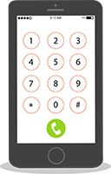
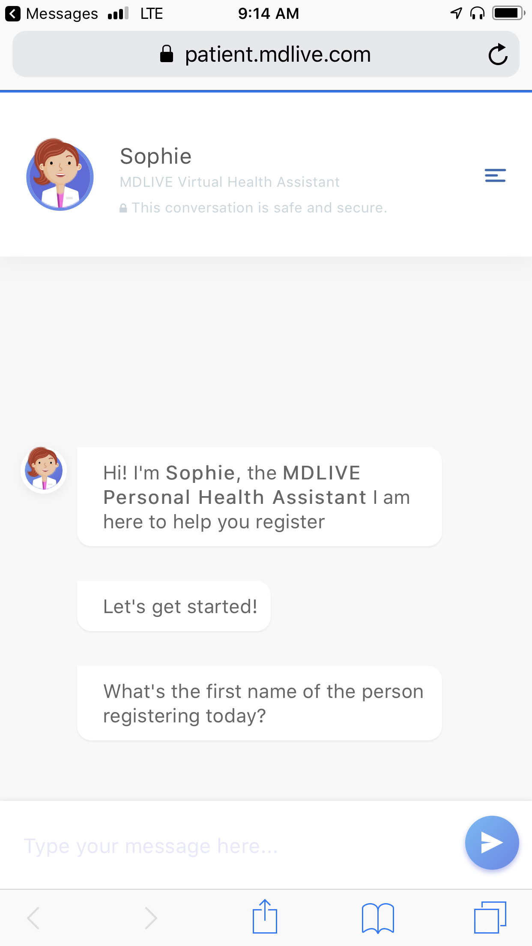
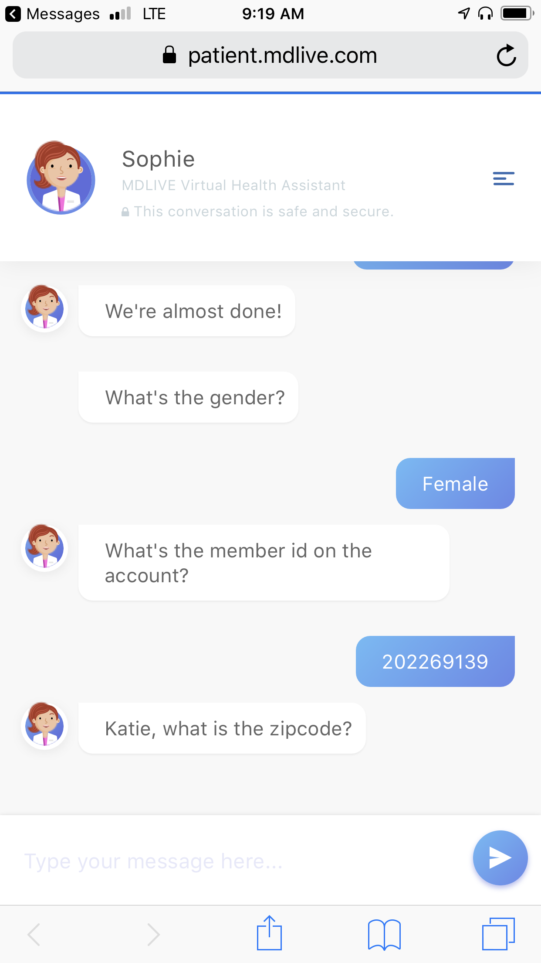
Telemedicine: Text Registration Option*
Telemedicine text registration is easy!
Text EXCELLUS to 635483, click the link and get started.
Enter name and member ID for person registering.
Audio Call In: 1-855-852-7677
Access Code: 2384263
*Availability varies per group
Notes:
As mentioned, the text registration is the newest and simplest way to register and create your account with MDLIVE. Simply text the word “Excellus” to 635-483 which is MDLIVE numerically. Click on the link that is provided to get started!

Slide 7

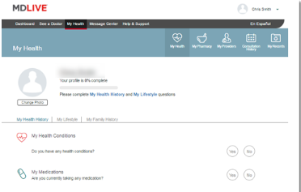

Telemedicine: Using MDLIVE*
Get Started
Complete your health profile (one time)
Add dependents, spouse, pharmacy and healthcare provider, and any health condition information
Audio Call In: 1-855-852-7677
Access Code: 2384263
*Availability varies per group
Notes:
Once you create your account you can login by going to MDLIVE.com or by logging in through the app. The first time you log in, you are encouraged to complete your Health Profile. This only needs to be done once and can be saved going forward, but you have the option to go in and edit at any time!.
Be sure to include any information that you would like an MDLIVE provider to know, such as any current medical conditions, prescriptions, etc. You can input your pharmacy information in the “My Pharmacy” tab so any prescriptions that may be written can be electronically faxed right to your pharmacy and all you will have to do is go pick them up! You can also input your Primary Cary Physicians information in the “My Providers” tab and you have the option to have a clinical summary of your MDLIVE visit electronically faxed to your PCP at the end of each visit.

Slide 8

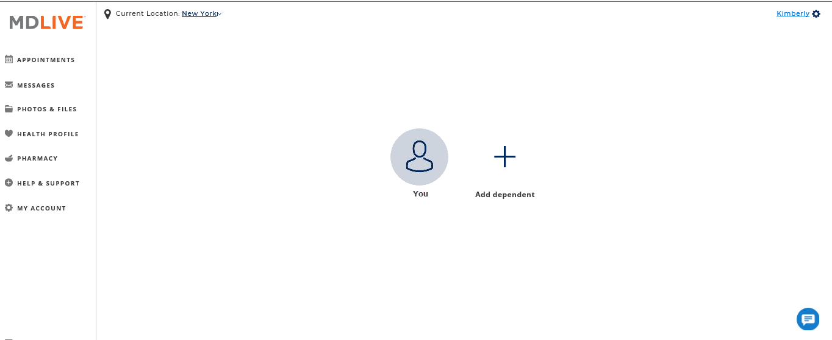
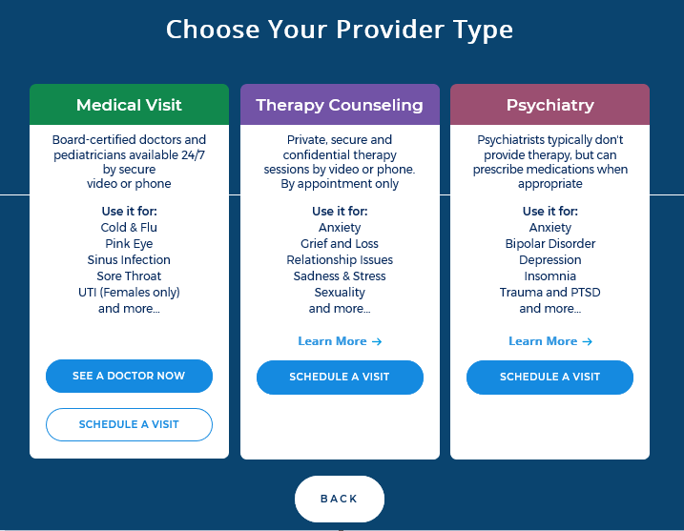
Telemedicine: Using MDLIVE*
1
2
1
Choose you or your family member
2
Select the type of visit
Audio Call In: 1-855-852-7677
Access Code: 2384263
*Availability varies per group
Notes:
So what is the process to set up an appointment with an MDLIVE provider?
Once you create your account and log in, you will first choose who the visit is for, such as yourself or a dependent you may have on your account. From there you will be directed to your dashboard where you will have choices on which provider you can schedule with- There is a medical visit, therapy counseling, or psychiatry visit. The costs of each visit type will be displayed for you on your dashboard as well.
For a medical visit, you can schedule a visit for a time that works best for your schedule or you can “See a Doctor Now” which will connect you with the next available doctor. It is important to note that all appointments for behavioral health must be scheduled in advance but as mentioned appointments are available anytime of day or night.
Once you select the visit type, you will answer a few short questions about your chief complaint, such as a sore throat or rash. Once you answer the short questionnaire, it will populate a list of providers that you have the option to chose from. You can see the providers availability, credentials, languages spoken, and more to help you make a provider choice that you are comfortable with!
Once you chose a provider and time of your appointment, you will provide a contact number to be reached at and the provider will call you at the time of your appointment!

Slide 9

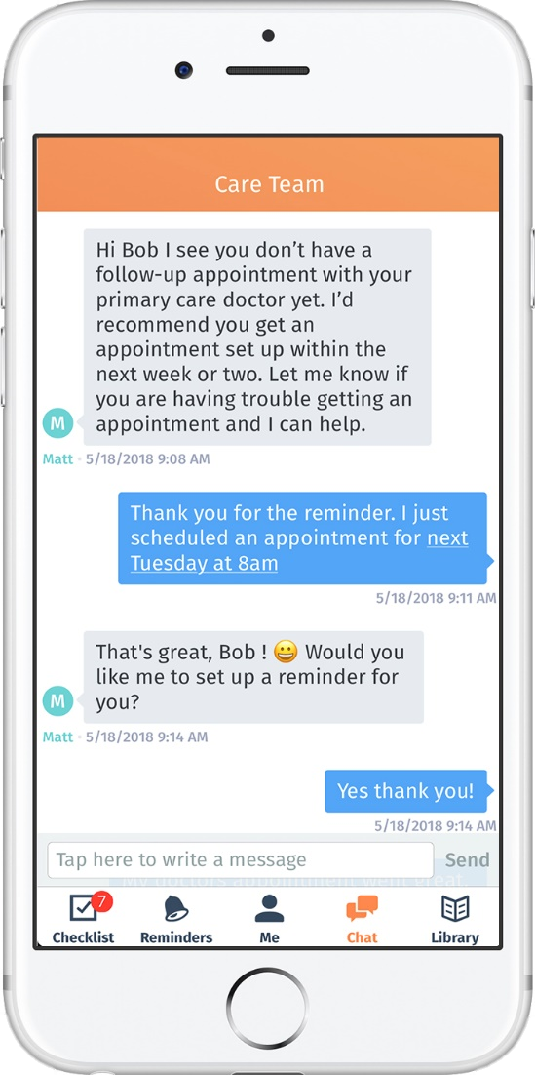
Wellframe Helps You Connect
What is Wellframe? A mobile app for smartphones or tablets that connects you to your Excellus BCBS Member Care Management Team.
Chat with your care team
Get medication reminders
Get answers to everyday clinical questions
Find a support group or explore available
resources
Learn about a diagnosis
Manage a condition
Access health related articles and videos
And more!
Access Code: Excellus
Audio Call In: 1-855-852-7677
Access Code: 2384263
Stress Management
Notes:
Another way to connect with our Care Management team is through the app Wellframe. The free app providers a direct line to internal staff and can help you set up appointment and medication reminders, learn about a diagnosis, set daily tasks, manage a condition, access articles and videos, and more!! You can download the wellframe app on any smart device for free and the access code to use is Excellus.
Again, during this lock down, Wellframe is a great resource not just to engage with care managers, but also to manage your personal health or stay on track with your healthy lifestyle goals. There are self guided modules for stress management, weight management and tobacco cessation included on the app. You can choose to engage with a health coach or care manager throughout your program.

Slide 10
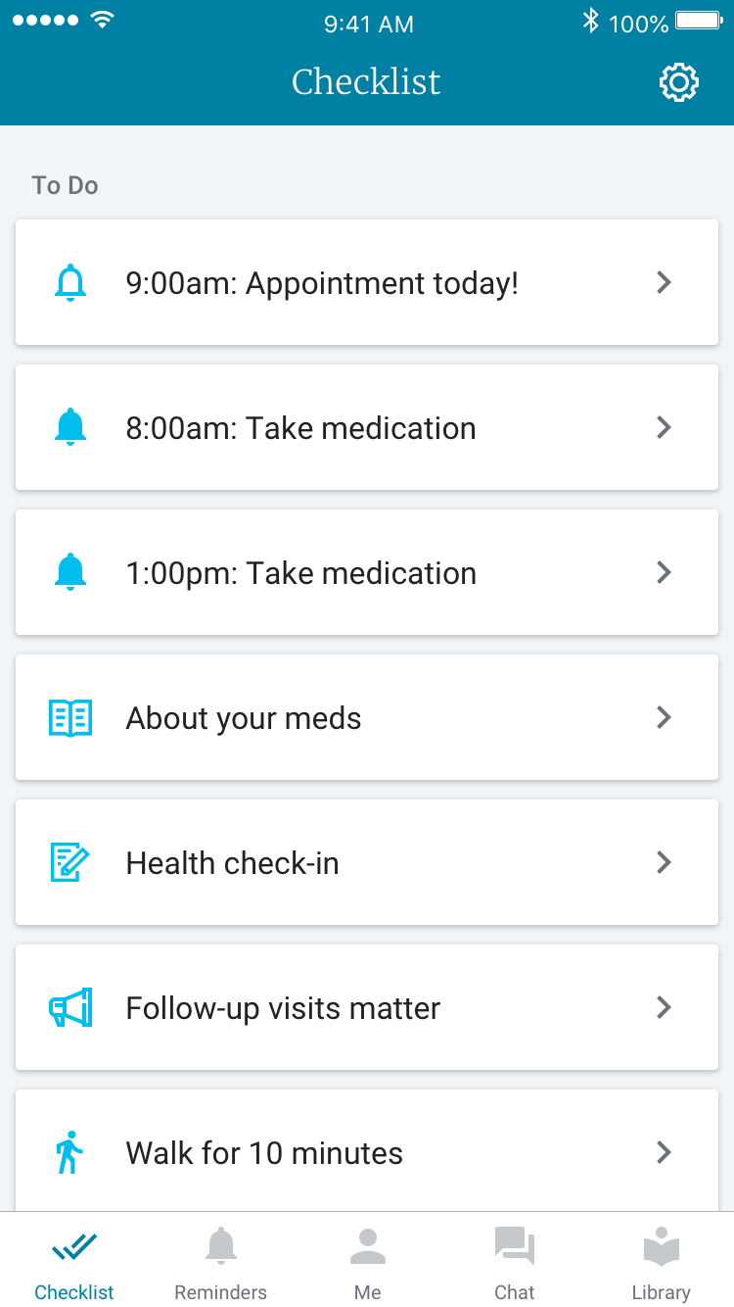
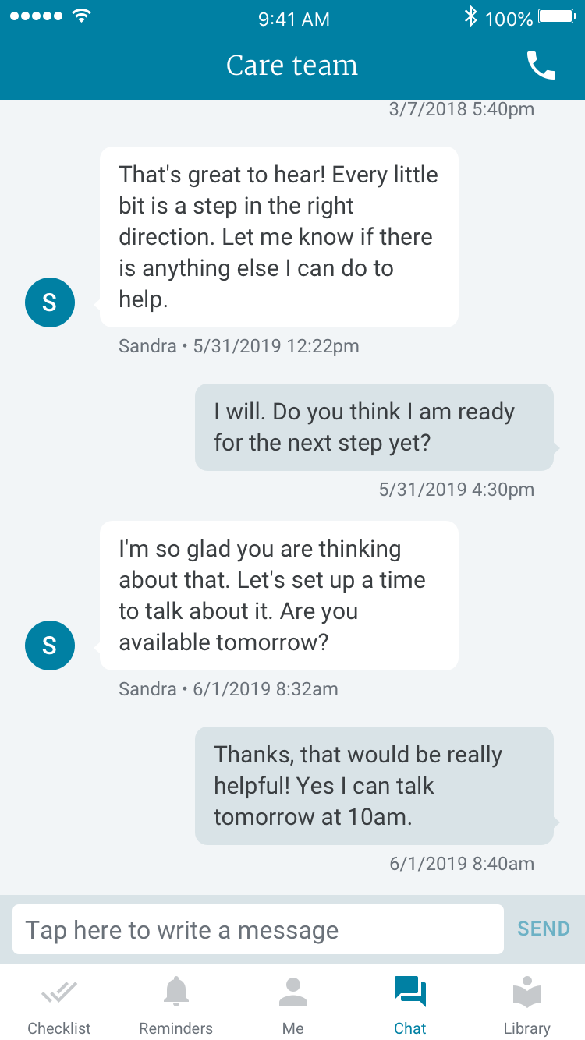
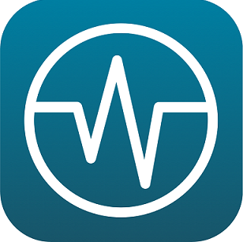
Wellframe App
Anxiety
Behavioral Health
Depression
Bipolar
Maternal Health
PTSD
Substance Abuse
Schizophrenia
Asthma
Coronary Artery Disease
Pre-Procedure
Care Transitions
Pre-Discharge
Post-Discharge (Surgical)
Post-Discharge (Medical)
Congestive Heart Failure
Diabetes Prevention
Weight Loss
Diabetes
Physical Activity
Smoking
Wellness & Prevention
Gaps in Care
Stress Management
Audio Call In: 1-855-852-7677
Access Code: 2384263
Notes:
As mentioned, the Wellframe app can help with a variety of conditions, including Behavioral Health, Maternal Health, Asthma, Coronary Artery Disease, Care Transition, Congestive Heart Failure, Diabetes and diabetes prevention, as well as a variety of health and wellness programs such as weight loss, physical activity, gaps in care and stress management. The app has a “chat” feature where you can simply text your questions to a Care Manager and you will get a response typically within 2 business days through the secure, HIPPA compliant portal.

Slide 11
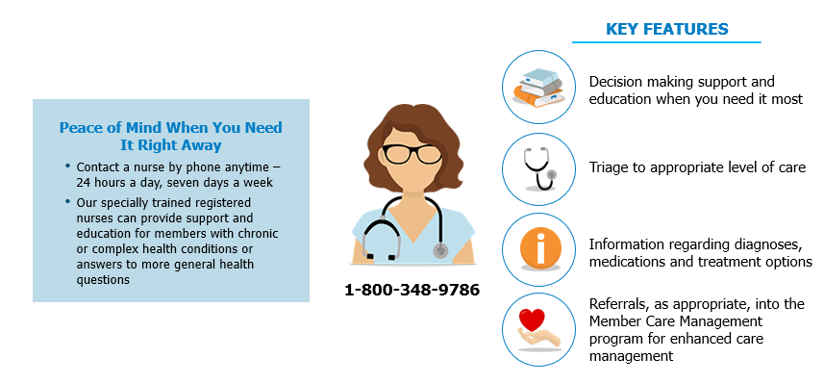
24/7 Nurse Call Line

